Slide 1
Identifying variable strains in the microbiome
Adrian Verster (averster@uw.edu)
May 2nd, 2017

Slide 2
Outline
Compositional data
What does it mean for data to be compositional and what problems does it create?
Compositional data and correlation
The Sparcc method
Avoiding compositional data
Transforming compositional data
The PhILR method for transforming out of a compositional space

Slide 3
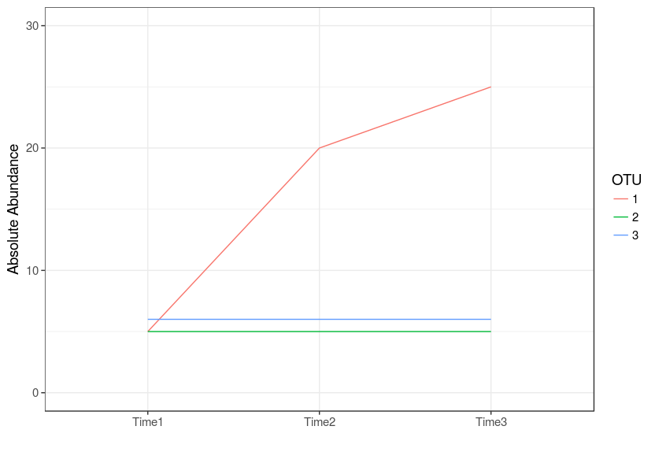
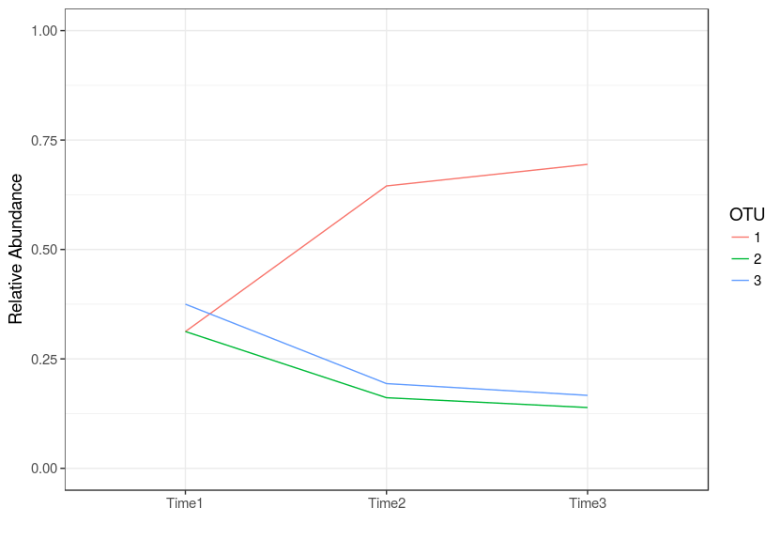
Recall compositional problems

Slide 4
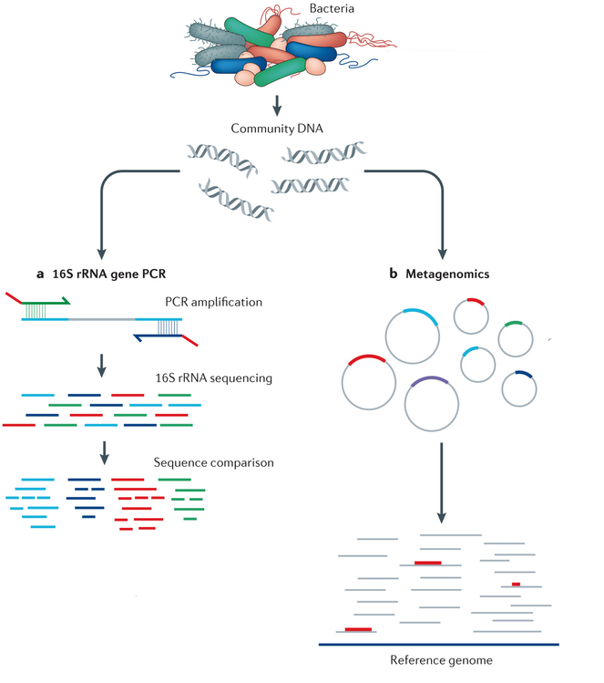
A modern metagenomics sequencing pipeline
Lasken and McLean 2014

Slide 5
Universal single-copy genes (USiCGs)
Marker genes that appear in all microbial genomes
Almost always in a single copy
Universal single-copy marker genes should not vary in abundance between different samples.
Notes:
- In order to study the impact of compositional normalization, I focused on a set of universal single-copy genes

Slide 6
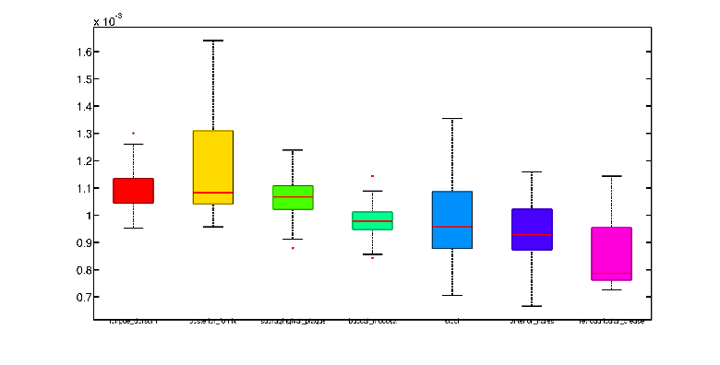
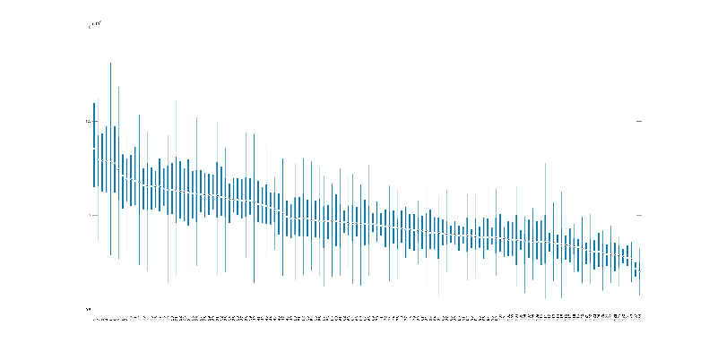
Compositional normalization introduces biases
1.7
x10⁻³
1.5
1.3
Median abundance of USiCGs
1.1
0.9
0.7
x10⁻³
Tongue dorsum
Supragingival plaque
Stool
Retroauricular crease
1.5
Tongue dorsum ; Posterior fornix Supragingival plaque ; Buccal mucosa Stool ; Anterior nares Retroauricular crease
Posterior fornix
Buccal mucosa
Anterior nares
1.4
1.3
1.2
Median abundance of USiCGs in body site
1.1
1
x10⁻³
0.9
R=-0.78 P<0.05
2
0.8
0.7
1.2
1.3
1.4
1.5
1
1.1
1.6
1.5
Average genome size in sample (in Mb)
Abundance of USiCGs
1
0.5
HMP stool samples

Slide 7
Spurious intra-sample variation
Abundance of USiCGs
HMP stool samples

Slide 8
Modeling impact of gene properties
Gene properties
A
Universal single- copy genes
X
=
Abundance of USiCGs
β
y
Solved using elastic-net regularization:

Slide 9
Explaining intra-sample variation

Slide 10
The MUSiCC pipeline
The MUSiCC pipeline
Relative abundance of genes in the sample (obtained by shotgun metagenomic sequencing and annotation)
Correct intra-sample variation using marker-based regularized linear model
Normalize inter-sample variation using marker-based abundances
Average copy-number of genes across all genomes in the sample (the “average microbe”)

Slide 11
MUSiCC lowers inter-study variability
With relative normalization
After applying MUSiCC

Slide 12
Strain finding
What is a bacterial strain and why should we care?
What kind of variants can we use to detect variable strains in metagenomes?
Constrains – detecting strains based on population level variants.

Slide 13
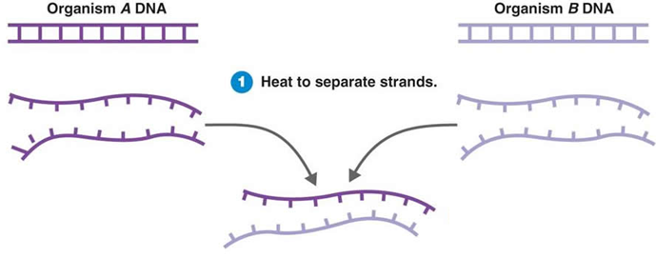
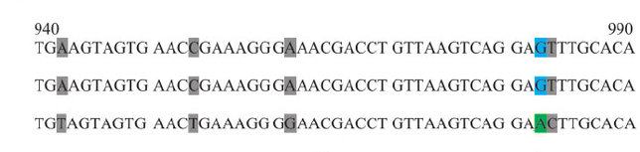
Recall – bacterial species
Phenotype based definition
DNA-DNA hybridization of 70%
16S identity of 97%

Slide 14
Definitions
Species - A group of prokaryotes that taxonomist has characterized based on phenotypes
Strain - A representative prokaryote from the species group
Operational taxonomical unit - A group of 16S sequences with at least 97% ID

Slide 15
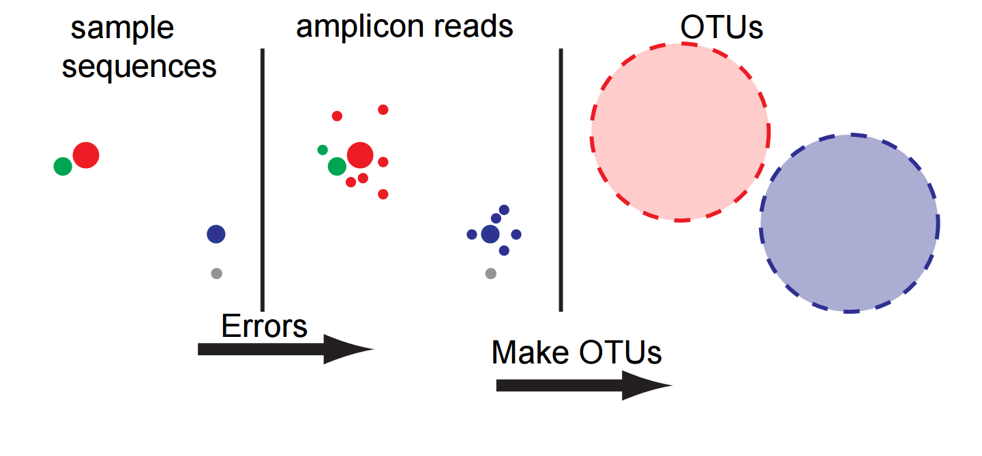
Does the within-species variation mean anything?

Slide 16
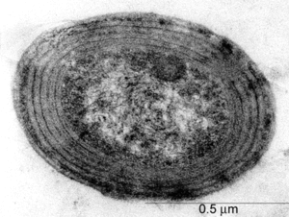
Prochlorococcus
Blue-green algae, photosynthetic bacteria which lives in the ocean
Might be the most abundant organism on earth (100,000 cells per ml of seawater)

Slide 17
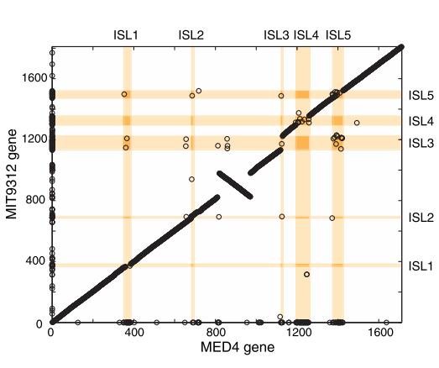
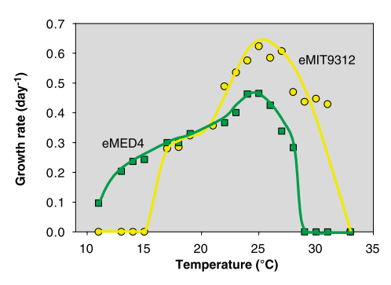
Prochlorococcus ecotypes
Strain difference is <1% in 16S sequence
But each strain has many specific genes

Slide 18
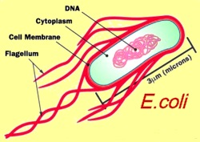
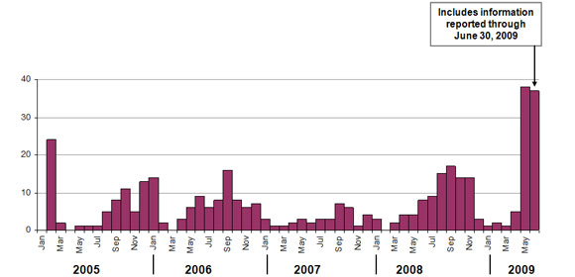
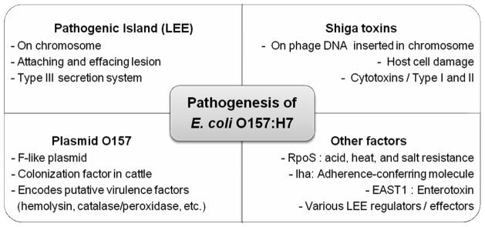
E. coli O157
Lim et al. 2016

Slide 19
Strain finding
What is a bacterial strain and why should we care?
What kind of variants can we use to detect variable strains in metagenomes?
Constrains – detecting strains based on population level variants.

Slide 20
Variants
SNV – single nucleotide differences between strains of the same species
CNV – copy number variation of genes from duplications and deletions

Slide 21
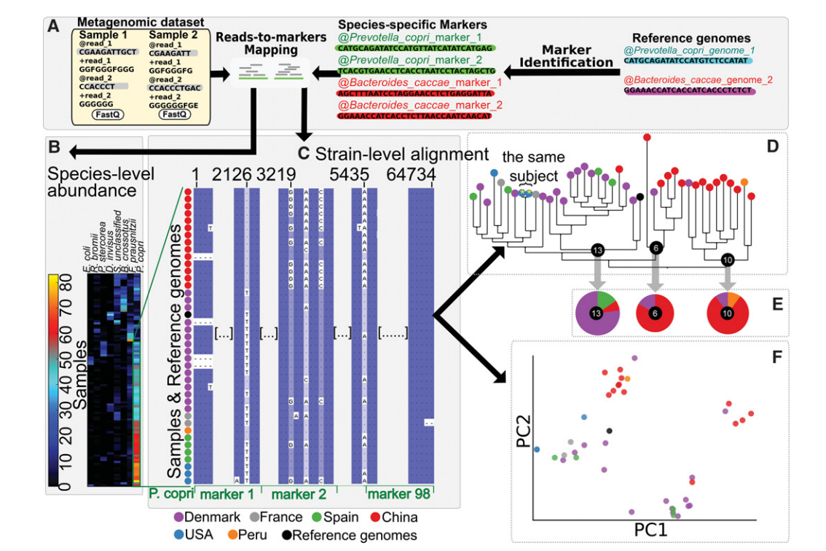
How can we detect strains in metagenomes?
Truong et al. 2017
Notes:
They are only looking at the major allele at every position
By discarding the minor allele they are ignoring the fact that the microbiome is a mixture of species
How can we account for multiple strains per sample?

Slide 22
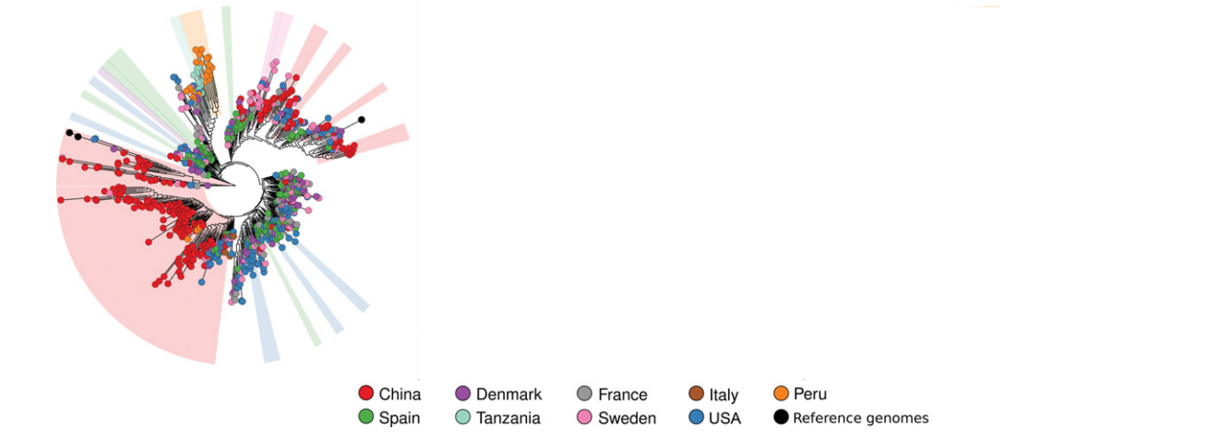
This allows you to compare microbiome strains to published genome sequences
Faecalibacterium prausnitzii
Notes:
They are only looking at the major allele at every position
By discarding the minor allele they are ignoring the fact that the microbiome is a mixture of species
How can we account for multiple strains per sample?

Slide 23

Calling variants in human genetics
Reference
G
Reads
A
A
A
A/A
Sequencing error
A
T

Slide 24

Calling variants in the microbiome
Reference
G
Reads
A
A
80%
A
A
T
20%
A
Sequencing error?
T
Notes:
Is this sequencing error? Or is this a variable strain present in the microbiome?

Slide 25
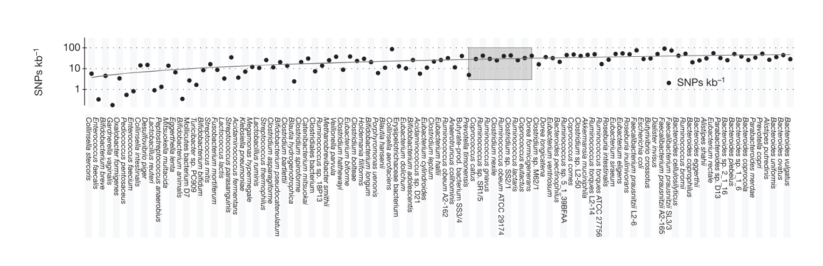
Early work detecting SNVs in metagenomes
“We performed SNP calling on the pooled samples and only considered bases with a quality score >=15. We required SNPs to be supported by >=4 reads and to occur with a frequency of >=1%.”
Schloissnig et al. 2013

Slide 26
Strain finding
What is a bacterial strain and why should we care?
What kind of variants can we use to detect variable strains in metagenomes?
Constrains – detecting strains based on population level variants.

Slide 27
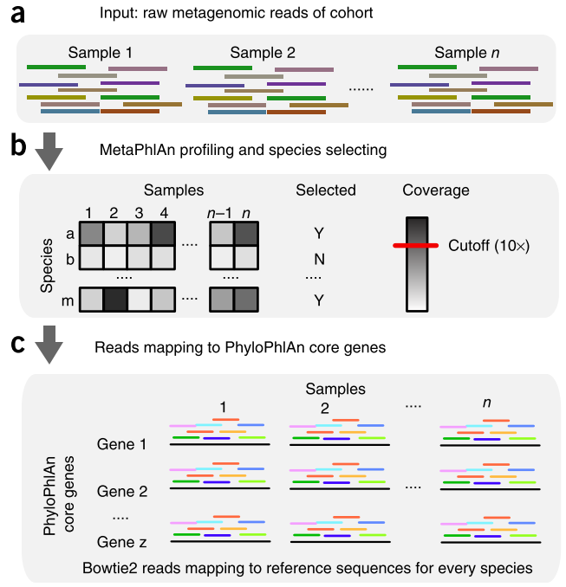
Conspecific Strains (Constrains)

Slide 28
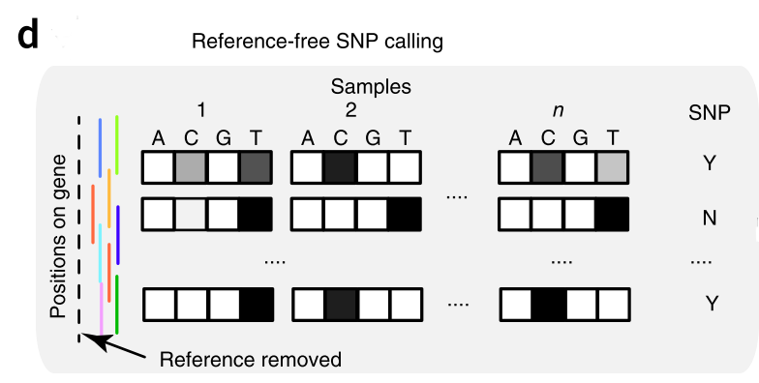
SNP identification

Slide 29
Recall, other methods take only the most abundant allele

Slide 30
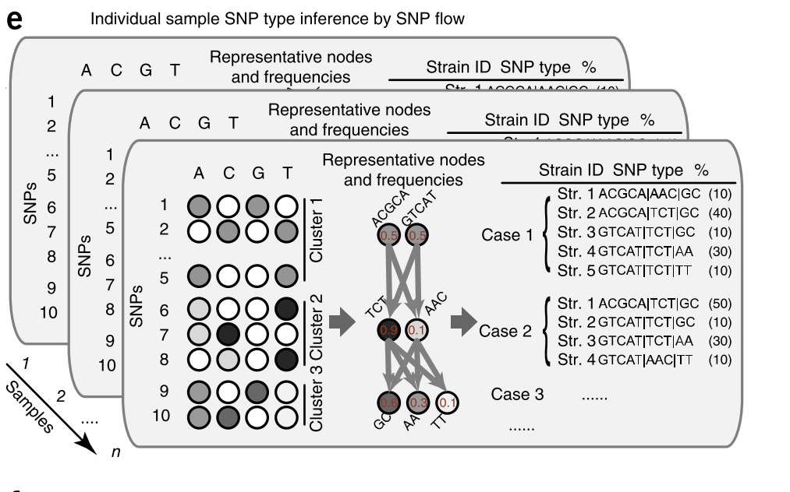
SNP flow algorithm
ACGCA
GTCAT
0.5
0.5
TCT
AAC
0.9
0.1
GC
AA
TT
0.6
0.3
0.1

Slide 31
Some intuition
Strain1
Abundance: 0.10
Genotype: ACGCA | AAC
Strain1
Abundance: 0.10
Genotype: GTCAT| AAC
ACGCA
GTCAT
0.5
0.5
0.4
Strain2
Abundance: 0.40
Genotype: ACGCA | TCT
Strain2
Abundance: 0.40
Genotype: GTCAT| TCT
TCT
AAC
0.1
0.9
0.0
Strain3
Abundance: 0.50
Genotype: GTCAT| TCT
Strain3
Abundance: 0.50
Genotype: ACGCA| TCT

Slide 32
SNP flow algorithm
ACGCA
GTCAT
0.5
0.5
0.4
0.0
TCT
AAC
0.1
0.9
0.0
0.5
GC
AA
TT
0.6
0.3
0.1
0.5
0.1

Slide 33
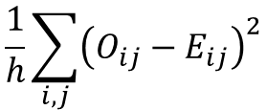
Which is a better fit?
They choosing the best set of strains to minimize the error function
Strain1
Abundance: 0.10
Genotype: ACGCA | AAC
Strain1
Abundance: 0.10
Genotype: GTCAT| AAC
$$E_{A1}=0.1∗1+0.4∗1+0.5∗0$$
$$\frac{1}{h}\sum_{i,j}{{\left(O_{ij}−E_{ij}\right)}^{2}}$$
Strain2
Abundance: 0.40
Genotype: ACGCA | TCT
Strain2
Abundance: 0.40
Genotype: GTCAT| TCT
$$E_{A1}=0.1∗0+0.4∗0+0.5∗1$$
i – position
j – base
Strain3
Abundance: 0.50
Genotype: GTCAT| TCT
Strain3
Abundance: 0.50
Genotype: ACGCA| TCT

Slide 34
So how do we decide on the strains?
Sample 1
Sample 2
ACGCA
GTCAT
ACGCA
GTCAT
0.5
0.5
0.8
0.2
Strain1
Abundance: 0.10
Genotype: ACGCA | AAC
Strain1
Abundance: 0.10
Genotype: GTCAT| AAC
TCT
AAC
TCT
AAC
Strain2
Abundance: 0.40
Genotype: ACGCA | TCT
Strain2
Abundance: 0.40
Genotype: GTCAT| TCT
0.9
0.1
0.3
0.7
Strain3
Abundance: 0.50
Genotype: GTCAT| TCT
Strain3
Abundance: 0.50
Genotype: ACGCA| TCT

Slide 35
This will only work if your strains change in abundance
Sample 1
Sample 2
Strain1
Abundance: 0.10
Genotype: ACGCA | AAC
Strain1
Abundance: 0.70
Genotype: ACGCA | AAC
Strain2
Abundance: 0.40
Genotype: ACGCA | TCT
Strain2
Abundance: 0.10
Genotype: ACGCA | TCT
Strain3
Abundance: 0.50
Genotype: GTCAT| TCT
Strain3
Abundance: 0.20
Genotype: GTCAT| TCT

Slide 36
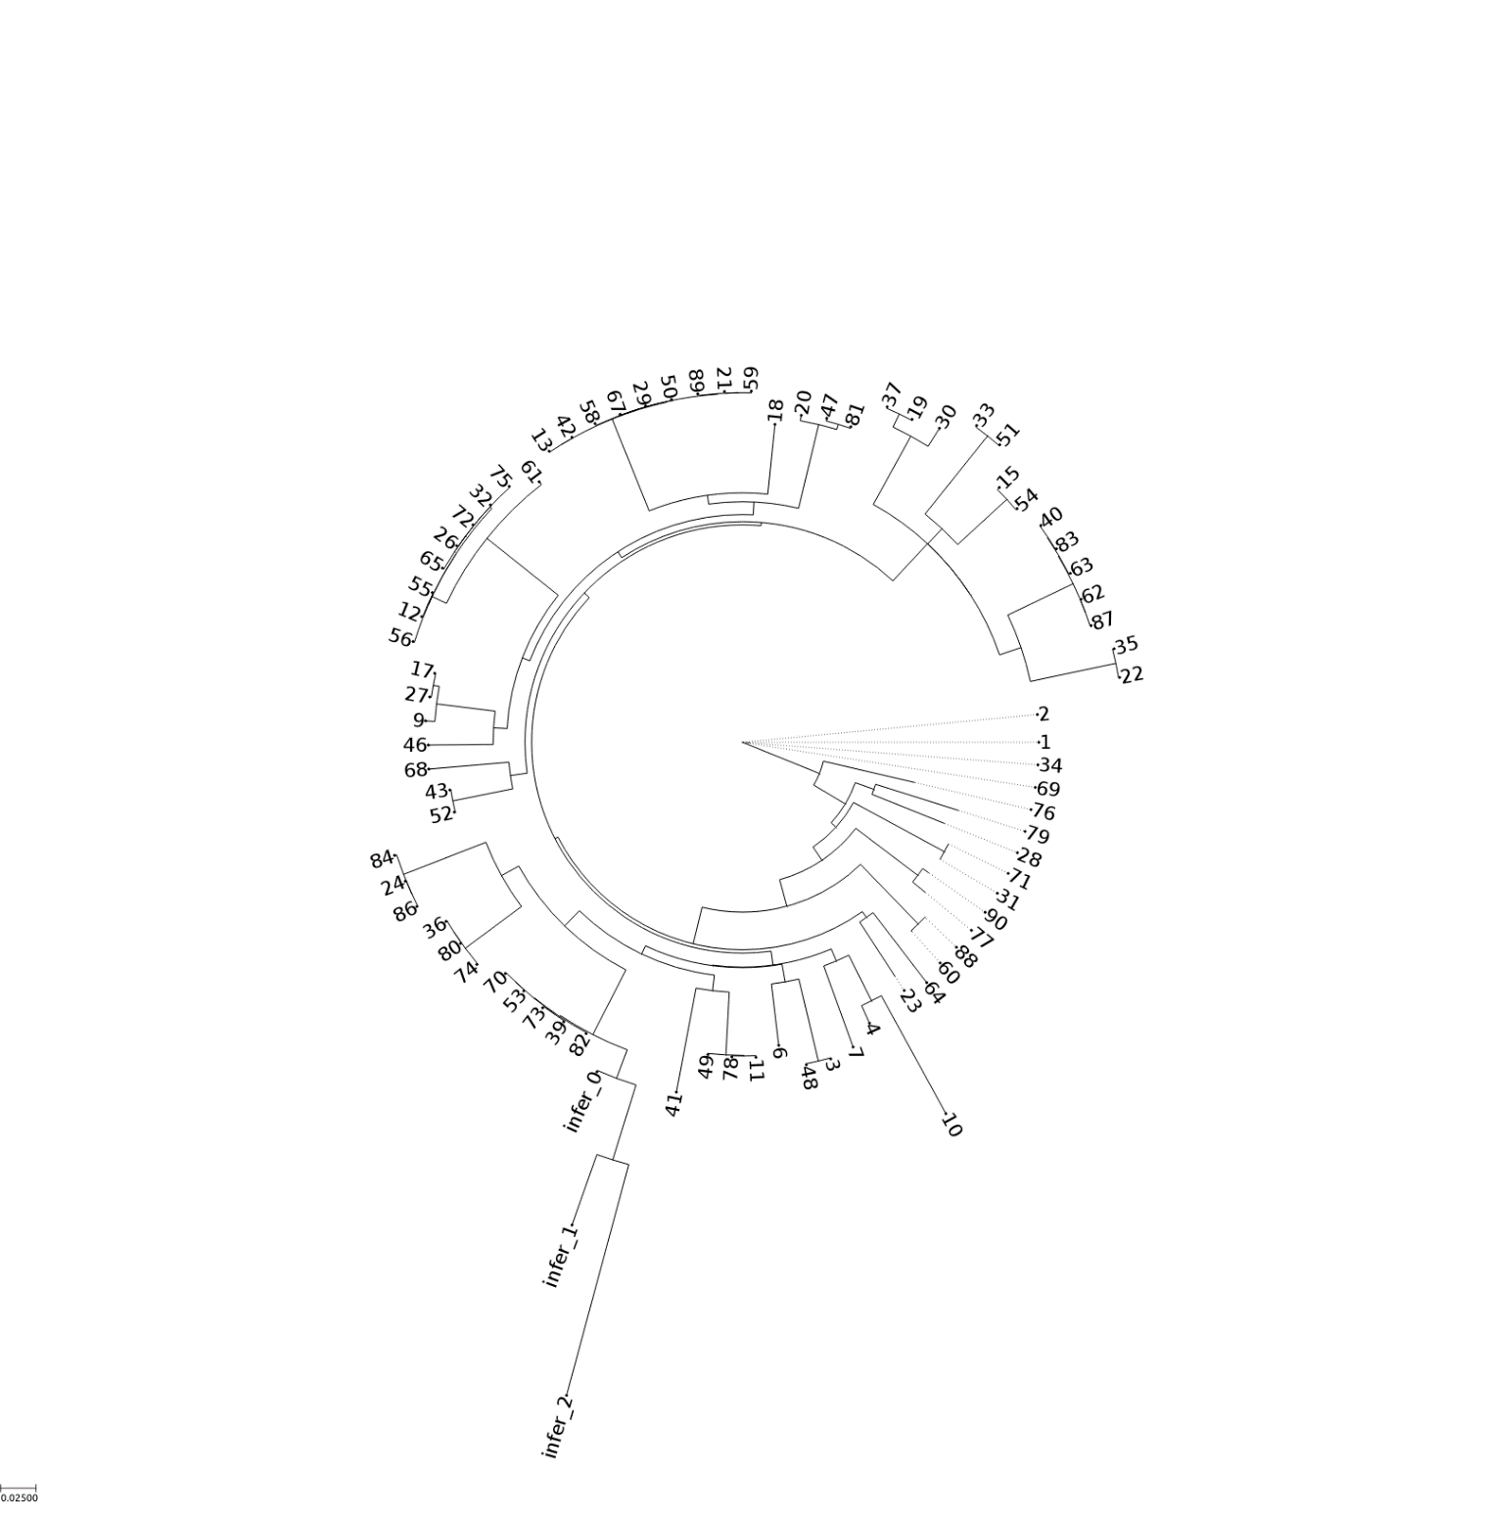
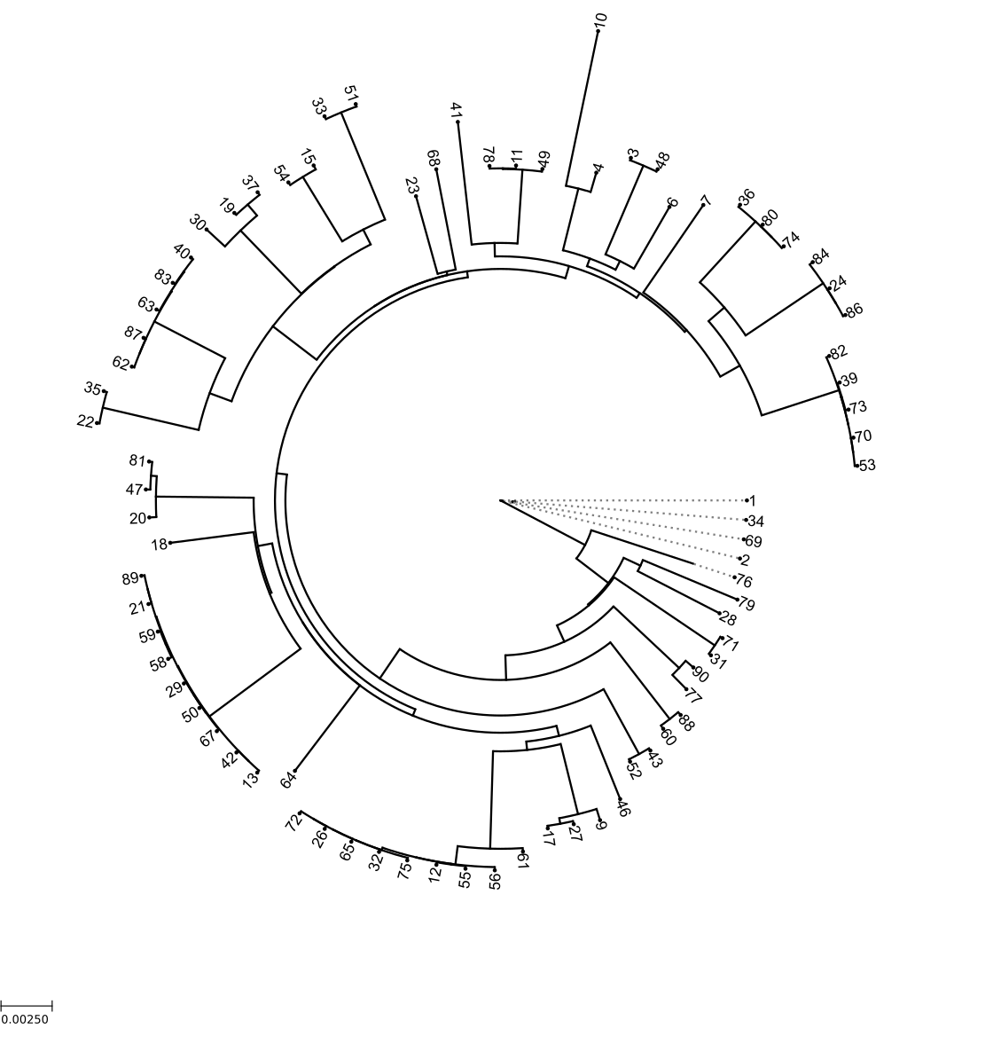
Where does this get you?

